Slide 1
Overview of Projects and Rakuten Case Study
Shreya Sharma

Slide 2
About Me
From India, working in Japan since Oct 2016
Education
B. Tech. in Electrical Engineering, GBPUAT Pantnagar, India
M. Tech. in Geoinformatics Engineering, IIT Bombay, India
Professional Experience
Image Processing Lab Teaching Assistant at IIT Bombay (1 year)
Data Science Researcher at NEC (3 years)
Research Achievements
3 Patents
5 Publications in top-level remote sensing conferences- IGARSS, SPIE
Foreign collaborations
Hobbies
Blogging
Social Activities
Volunteer at Hands-on-Tokyo NGO
Speaker at Machine Learning Tokyo

Slide 3
Career Interests
Research Interests
Domains
Computer Vision
Image Processing
Deep Learning
Statistical Analysis
Geospatial
Healthcare
E-commerce
Agriculture
Security

Slide 4
Overview of My Projects
Research Projects at NEC
Ship Classification for Maritime Surveillance
Change Detection in Time-series of Satellite Images
Land-use Land-cover Segmentation in Large-size Satellite Images
Master’s Thesis
Hyperspectral Image Super-resolution
Academic Projects
Dimensionality Reduction of Hyperspectral Images
Shape Detection using Hit and Miss Transform
Optimal Bike Path Development and Route Prediction
Feature extraction using Active Contour Models
More Information at: https://shreya1sharma.github.io/ShreyaSharma/projects/

Slide 5
Contents
Ship Classification for Maritime Surveillance
Change Detection in Time-series of Satellite Images
Current Work and Challenges
Collaboration Activities
Case Study: Brain Tumor Segmentation with MRI

Slide 6
Contents
Ship Classification for Maritime Surveillance
Change Detection in Time-series of Satellite Images
Current Work and Challenges
Collaboration Activities
Case Study: Brain Tumor Segmentation with MRI

Slide 7
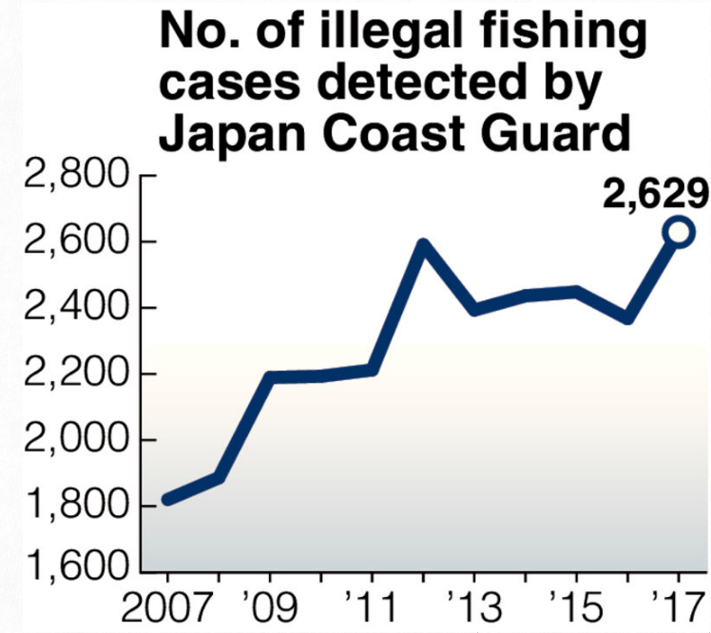
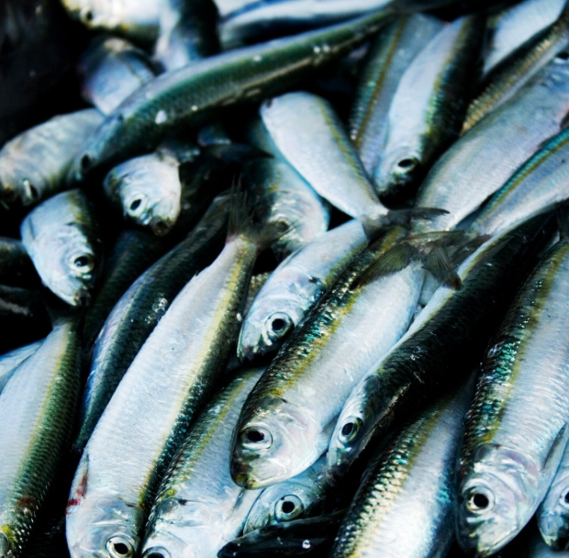
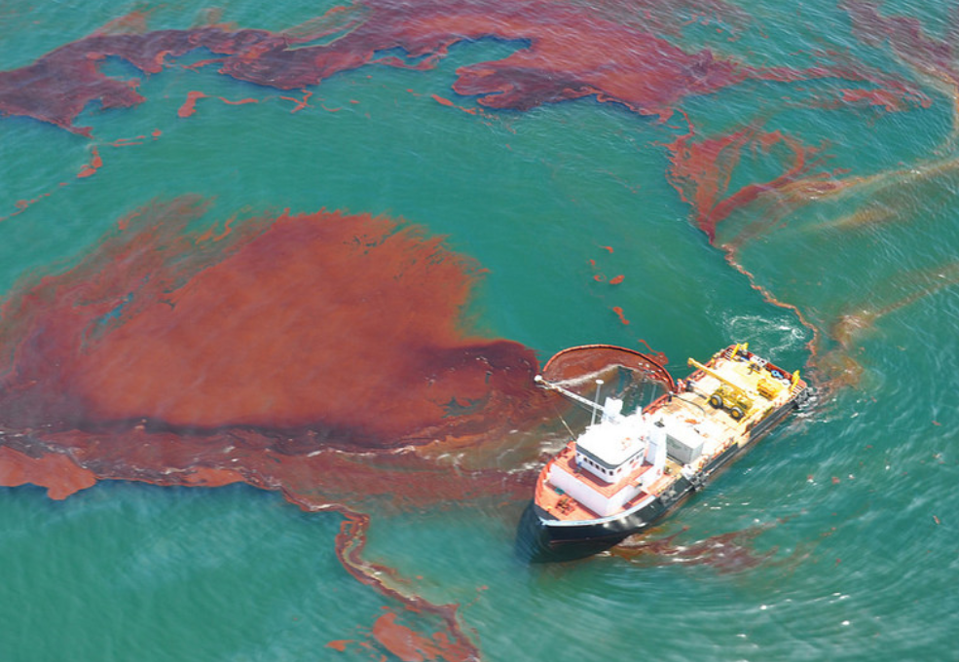
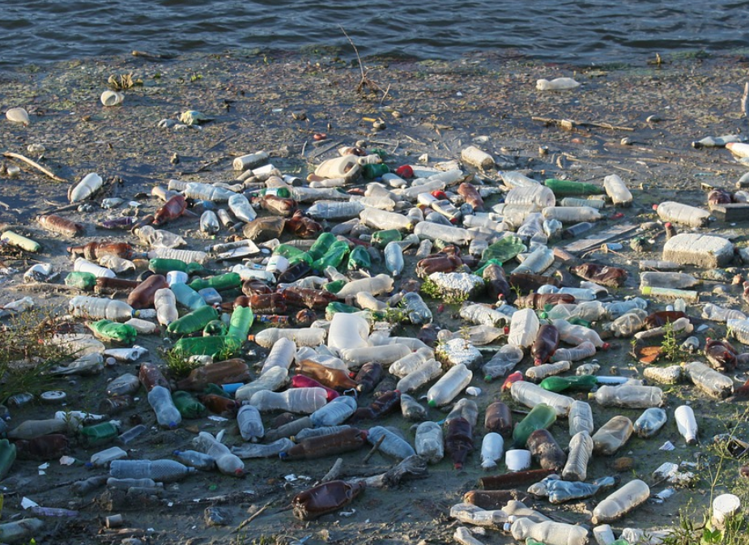
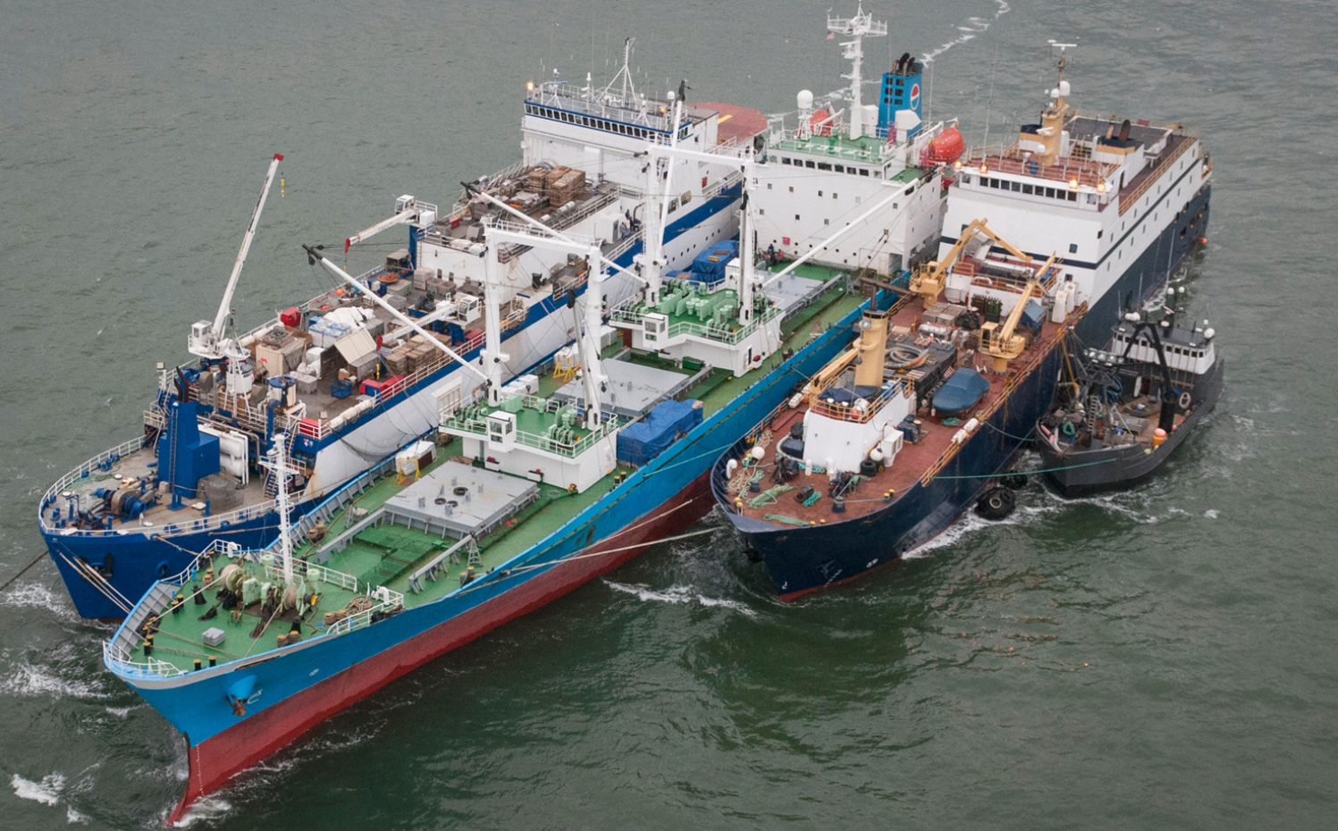
Motivation
Ship Classification is a key application in maritime surveillance
Helps in quick identification of ships involved in illegal activities
Overfishing
Oil-spills
© NOAA/CC BY 2.0
Garbage dump
Smuggling
©Yomiuri Shinbun, 28/02/2018
$US23 billion loss worldwide per year!
© Nature Magazine

Slide 8
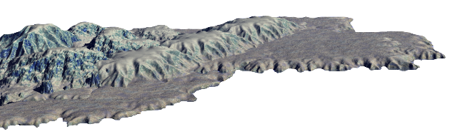
Ship Classification from Space
3 major sources of information : AIS, Visible and Microwaves
Microwaves can see ships undetected/spoofed by AIS and Visible
Automatic Identification System (AIS)
Visible
Undetected due to cloud
Microwaves
Can be easily spoofed by owner
Cannot hide
All time monitoring
Microwave images are highly reliable for ship classification

Slide 9
Conventional Methods
1. Hand-crafted feature (HCF)-based
Bounding Box
Feature extractor*
Classifier (SVM)
Class
© JAXA
*Length, Area, Intensity, … etc.
2. Convolutional Neural Network (CNN)-based
CNN
Class
© JAXA
Sharma et al., Comparative Analysis of feature extraction approaches for ship classification in moderate resolution SAR imagery, IEEE IGARSS 2018.
These methods classify a ship based on its appearance in image

Slide 10
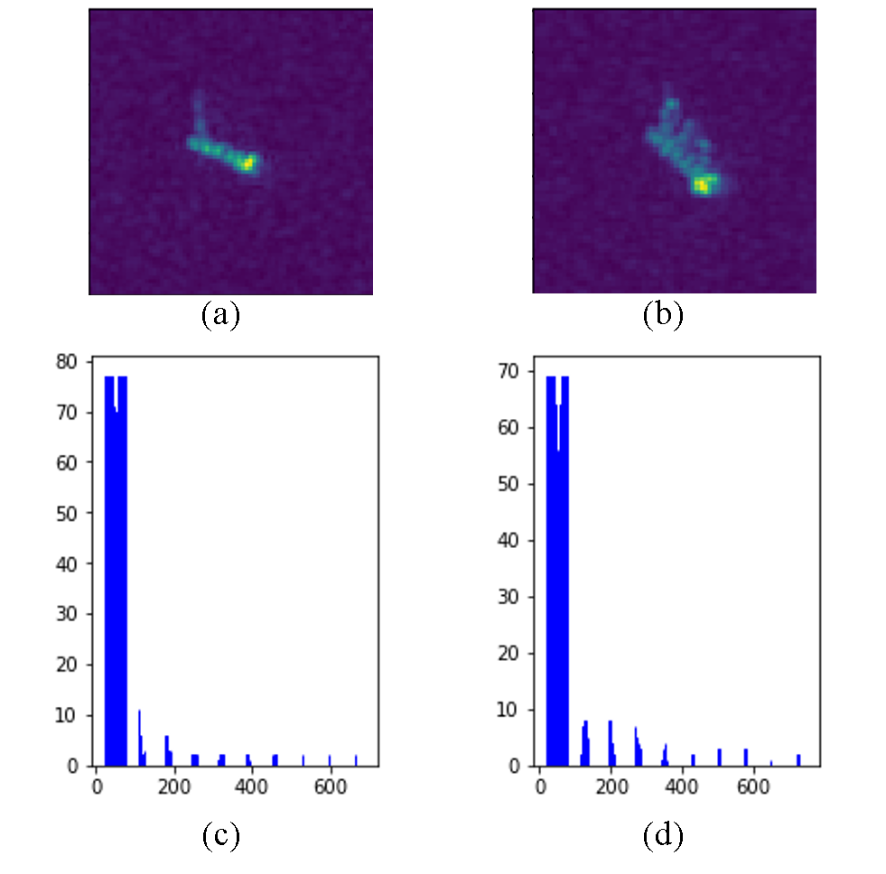
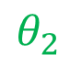

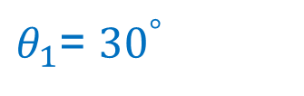
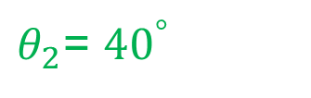
Problem
Appearance of a ship varies with satellite viewing angle
Labelled microwave images are very few to learn all possible variations
Example:
$θ_{1}$= ${30}^{°}$
Satellite
Range
$$θ_{1}$$
$$θ_{2}$$
Same ship viewed under different angles
© JAXA
$θ_{2}$= ${40}^{°}$
Azimuth
© JAXA
Only image information is insufficient for robust classification
Notes:
Explain briefly what is SAR geometry
For cnn to learn all these variations, huge training data is required, but it is not available in SAR.

Slide 11
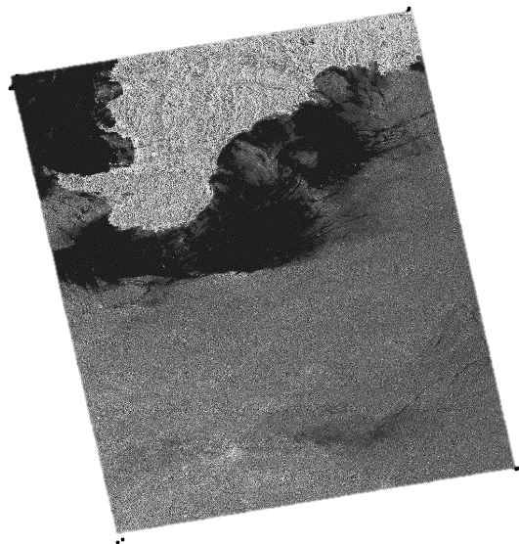



Proposed Method
Use viewing angle as an additional information in a NN
Helps the CNN to follow the appearance changes by learning a relationship
Image
Ship Images
CNN
Ship Class
© JAXA
© JAXA
Viewing angle map
Shows viewing angle at each pixel
Metadata
Extract Viewing Angle Map
$${40}^{°}$$
$${25}^{°}$$
Sharma et al., CNN-based ship classification method incorporating SAR geometry information, SPIE RS 2018.

Slide 12
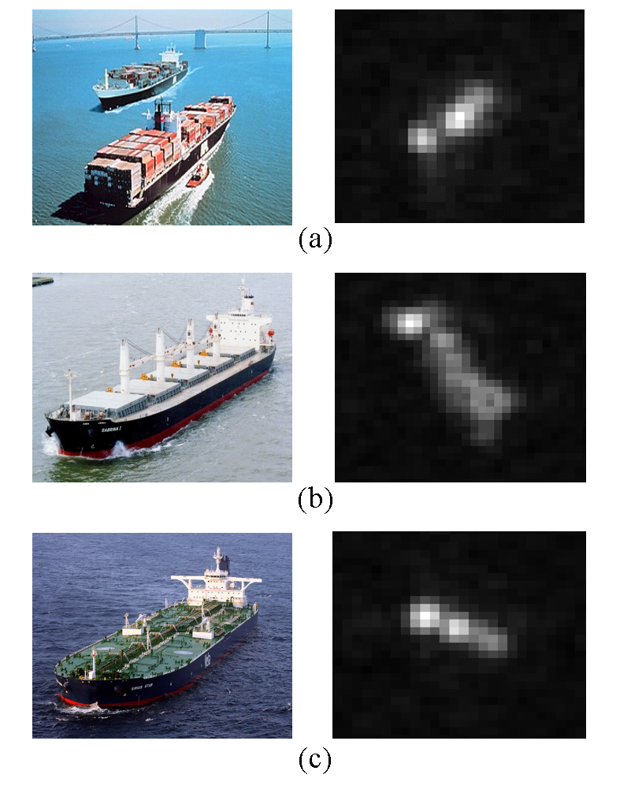
Experiments
Dataset: OpenSARShip*
Specifications
Satellite | Sentinel-1
Resolution | 20m
Image size | 128 x 128
No. images | 200 per class
Ground truth | AIS + Marine Traffic
Container
© NOAA
© ESA
© ESA
Bulk-carrier
Conventional Methods
© ESA
HCF | 10 Features + SVM
CNN | w/o incident angle
Tanker
Metrics
© ESA
f-measure | Higher is better
#training data needed | Lower is better
© ESA
*Huang, L et al., "OpenSARShip: A dataset dedicated to Sentinel-1 ship interpretation," IEEE Journal of Sel. Top. in App. Earth Obs. and Rem. Sen. 11(1), 195-208 (2018).

Slide 13
Results
4.2% improvement in
f-measure
25% reduction in
training data requirement
© ESA
Same Acc.
© ESA
© ESA
Proposed method outperforms the conventional methods

Slide 14
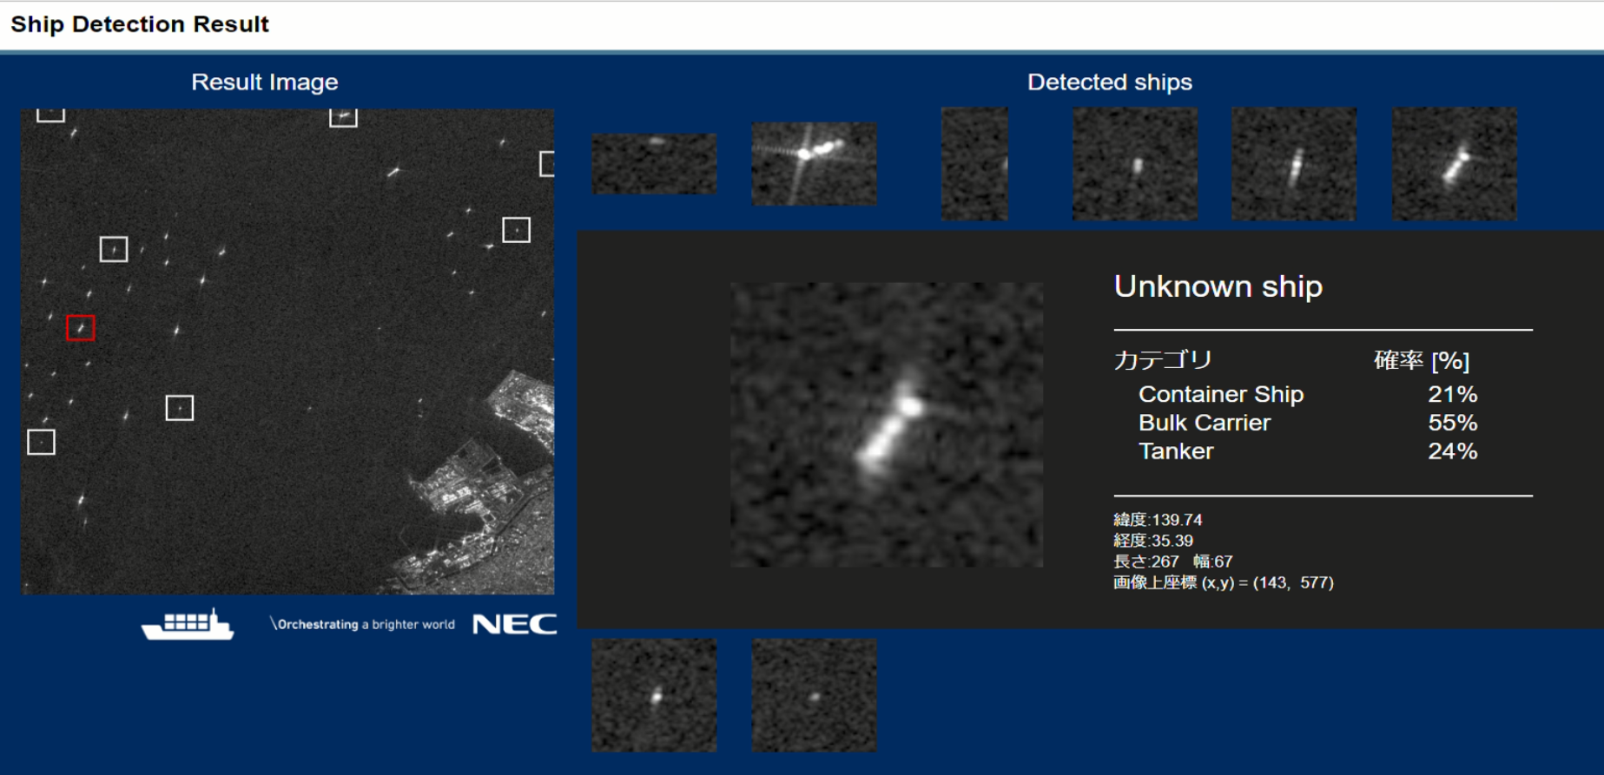
Demo Example
Presented at International Geosciences and Remote Sensing Symposium ‘19

Slide 15
Contents
Ship Classification for Maritime Surveillance
Change Detection in Time-series of Satellite Images
Current Work and Challenges
Collaboration Activities
Case Study: Brain Tumor Segmentation with MRI

Slide 16
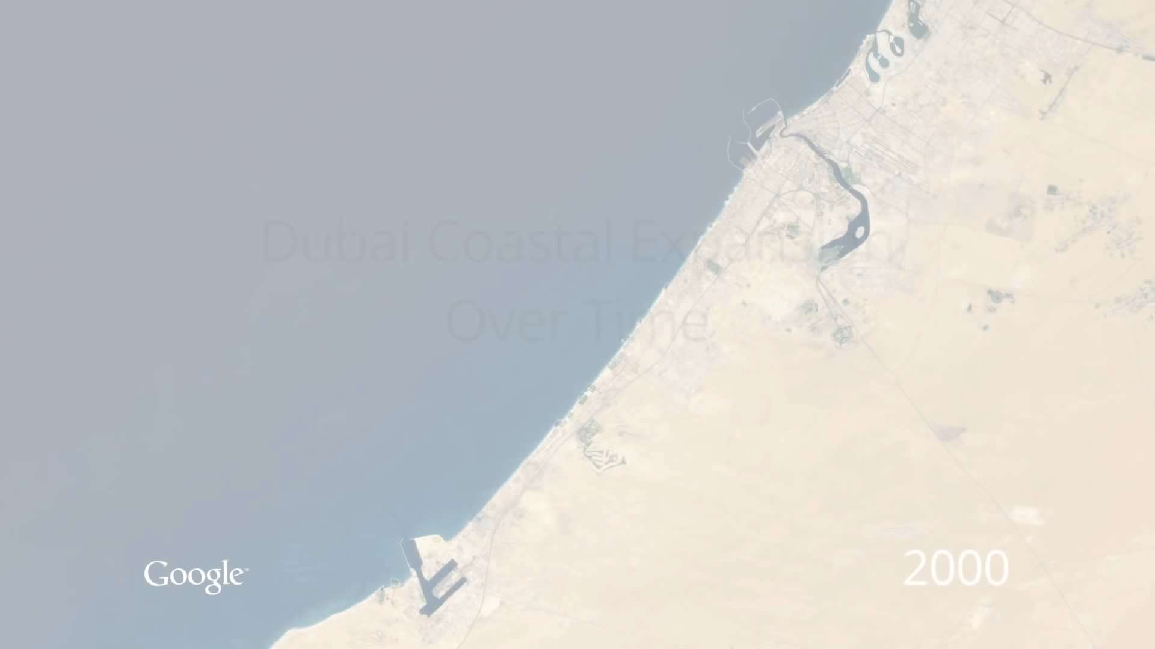
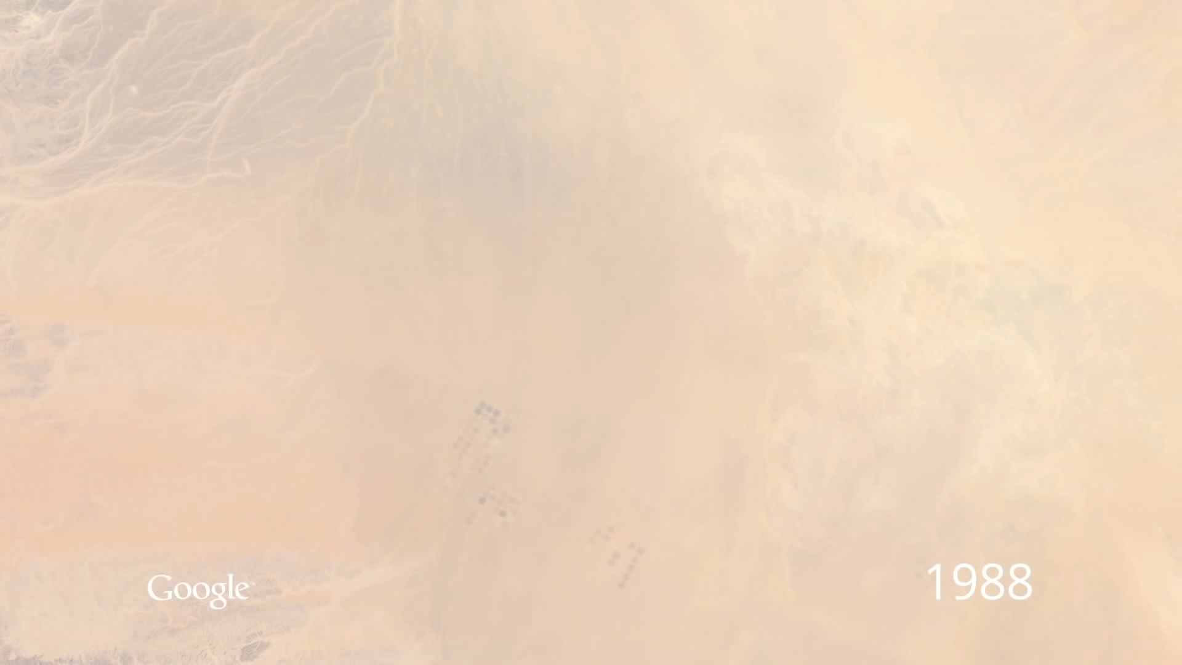
Motivation
Change detection enables us to understand dynamics of Earth
Dubai Coastal Expansion
Saudi Arabia Irrigation

Slide 17
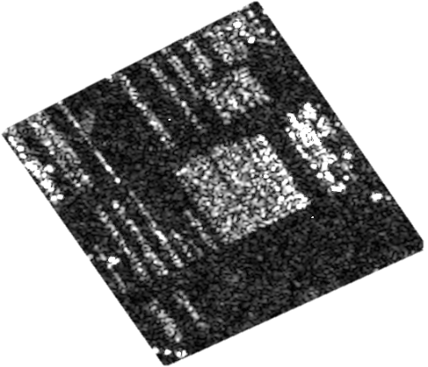
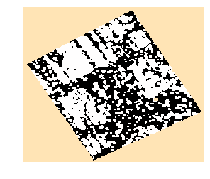
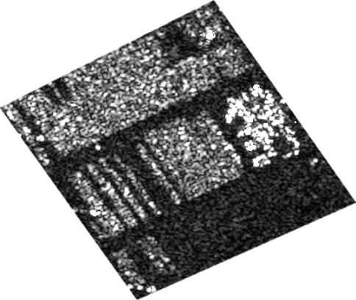
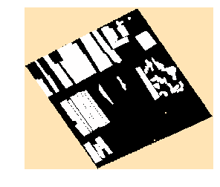
Conventional Method
Based on pixel-to-pixel difference followed by classification
Before Image
Change Map
Pixel-to-pixel difference
Classification
After Image
Ground Truth
Problem:
Many False Alarms!

Slide 18
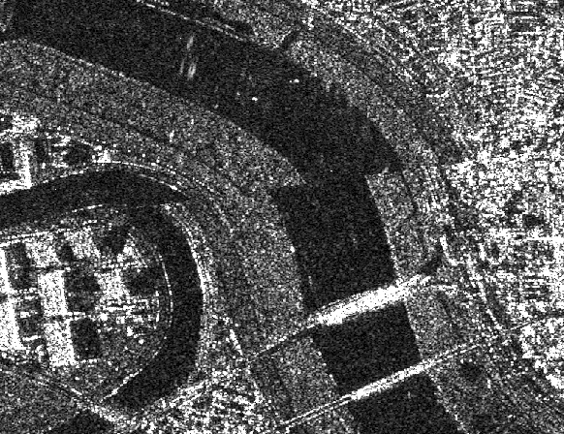
Problem
Pixel-to-pixel difference-based method cause many false alarms
Camera Jitter
causes co-registration error
Speckle
characteristic property in microwave image
causes noisy background
Camouflage
non-defined shape and boundary
difficulty to detect small and moving objects
Image 1
Image 2
© DLR
© DLR
© DLR
Low change detection accuracy
© DLR
© DLR

Slide 19
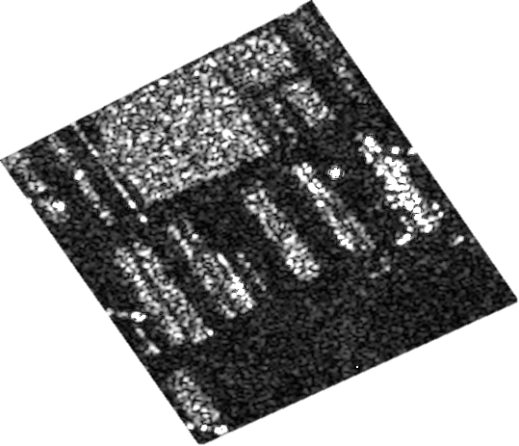
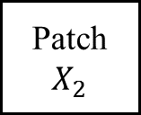

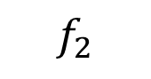
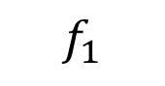
Solution
Feature-to-Feature difference method is robust to the conditions
Siamese network has been widely used for feature comparison
64x3x3
128
128
Image 1
64x3x3
2x2
64x3x3
Patch $X_{1}$
Conv
Conv
Poo l
Conv
FC
FC
$$f_{1}$$
Comparison
Share Weights
Image 2
Patch $X_{2}$
Conv
Conv
Poo l
Conv
FC
FC
$$f_{2}$$
 | Convolution
 | Max-pooling
 | Fully-connected

Slide 20

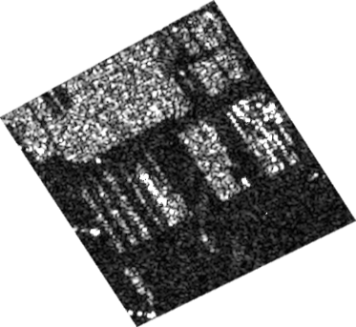

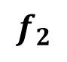
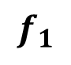
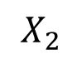
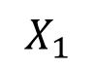
Proposed Method
Transform the images into features and compute difference between features
Before Image
Siamese Network
TRAINING
Conv
Conv
Pool
Conv
FC
FC
$$f_{1}$$
$$X_{1}$$
Patch Extraction
Distance Loss
Share Weights
Y true
After Image
Conv
Conv
Pool
Conv
FC
FC
$$X_{2}$$
$$f_{2}$$
TESTING
Change Map
Trained Siamese
Distance Calculation
Thresholding
Sharma et al., Very high resolution SAR change detection with Siamese Networks, The 66th Academic Conference of the Remote Sensing Society of Japan, 2019.

Slide 21
Experiments : Parking Lot Monitoring
…
Specifications
TerraSAR-X satellite
1m resolution
Baselines:
PCA-K [1]
SAE-K [2]
Evaluation Metrics
f-measure
Change Maps
[1] T. Celik: Unsupervised change detection in satellite images using principal component analysis and k-means clustering, IEEE Geoscience and Remote Sensing Letters, vol. 6, no. 4, pp. 772-776, 2009.
[2] M. Gong., H. Yang, and P. Zhang: Feature learning and change feature classification based on deep learning for ternary change detection in SAR images, ISPRS Journal of Photogr. and Remote Sensing, no.129, pp.212-225, 2017.
Dataset
t1
t2
t3
t9
t10
…
Site 1
…
Site 2
…
…
Site 3
Site 4
…
All images are copyrighted to DLR
…
Test
Site 5
Pair 1
Pair 2
Pair 9

Slide 22
Result [1/2] : f-measure
Proposed method improves f-measure by 15% over baselines
+0.04
+0.25

Slide 23
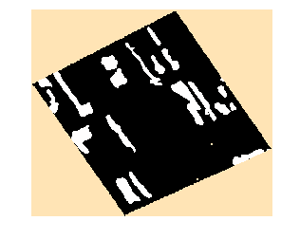
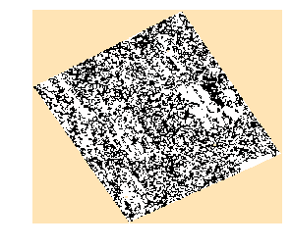
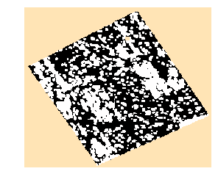
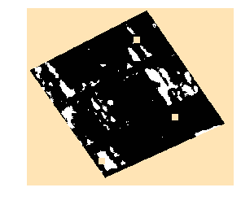
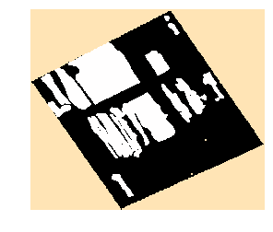
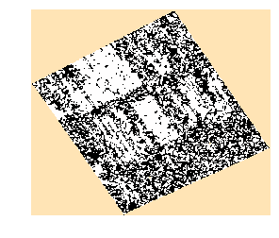
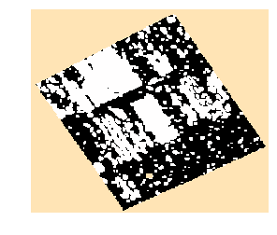
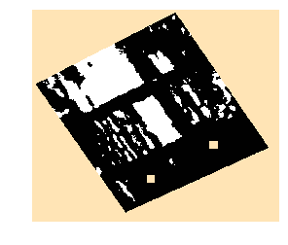
Result [2/2] : Change Maps
Proposed method produces visually better change maps
Ground Truth
PCA-K
SAE-K
Proposed
Pair 1
Pair 2

Slide 24
Result [2/2] : Change Maps
Proposed method produces visually better change maps
Ground Truth
PCA-K
SAE-K
Proposed
Pair 1
Pair 2

Slide 25
Contents
Ship Classification for Maritime Surveillance
Change Detection in Time-series of Satellite Images
Current Work and Challenges
Collaboration Activities
Case Study: Brain Tumor Segmentation with MRI

Slide 26
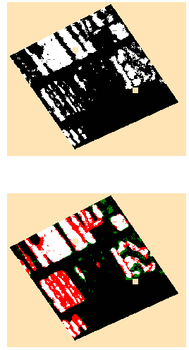
Current Work: Improving Proposed Method
False Negatives show that many foreground areas are undetected
Ground Truth
Colorized Change Map
Legend: TP, TN, FP, FN
Research Question: Can we improve the detection of foreground?
Use additional information that focus attention on foreground

Slide 27
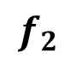
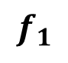
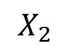
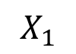
Multitask Siamese Network
Add foreground classification task as a support to change detection task
Multitask Siamese Network
TRAINING
Before Image
Cross-entropy Loss
Conv
Conv
Pool
Conv
FC
FC
$$f_{1}$$
$$X_{1}$$
Patch Extraction
Distance Loss
Combine Loss
Share Weights
After Image
Conv
Conv
Pool
Conv
FC
FC
Cross-entropy Loss
$$X_{2}$$
$$f_{2}$$
TESTING
Change Map
Trained Multitask Siamese
Distance Calculation
Thresholding

Slide 28
Contents
Ship Classification for Maritime Surveillance
Change Detection in Time-series of Images
Current Work and Challenges
Collaboration Activities
Case Study: Brain Tumor Segmentation with MRI

Slide 29
Collaboration Activities
Actively initiated several foreign and domestic collaborations
Institute | Outcome
European Remote Sensing Firm | Exhaustive feedback from an expert and knowledge of remote sensing business model
INRIA France | Built strong connection with foreign academia on ship classification project
University of Trento Italy | Built strong connection with foreign academia on change detection project
NEC Labs Europe | Initiated cross-lab collaboration opportunity
AIST Japan | Special lecture series by renowned professor and created business opportunity
Kyushu University | Feedback on the current change detection project and obtained useful references
Notes:
Biz. -analysis ready data provider

Slide 30
Contents
Ship Classification for Maritime Surveillance
Change Detection in Time-series of Images
Current Work and Challenges
Collaboration Activities
Case Study: Brain Tumor Segmentation with MRI

Slide 31

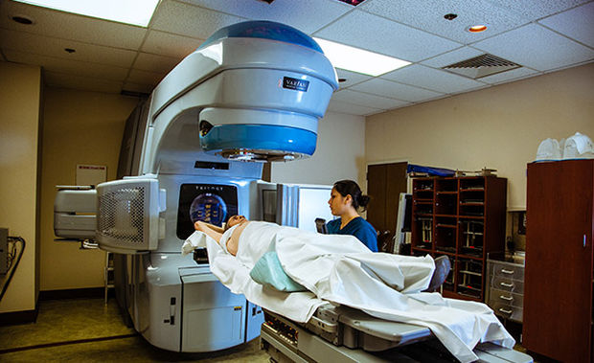
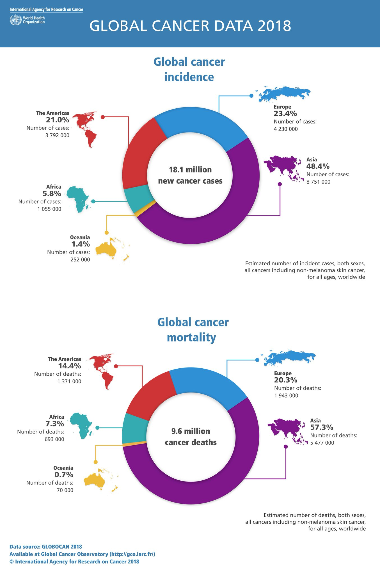
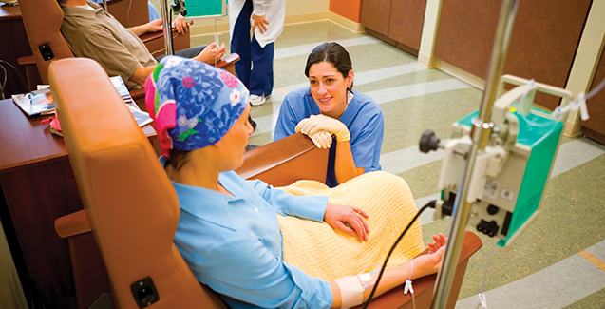
Motivation
50,000+ new brain tumor cases are reported in India each year
20% are children, tumor kills more children than any other disease
2018 Global Cancer Incidence
Treatments
SURGERY
RADIATION
CHEMO
Only 51% success
Very painful
Highly expensive
©GLOBOCON
90% cases could have been cured if detected early and correctly

Slide 32
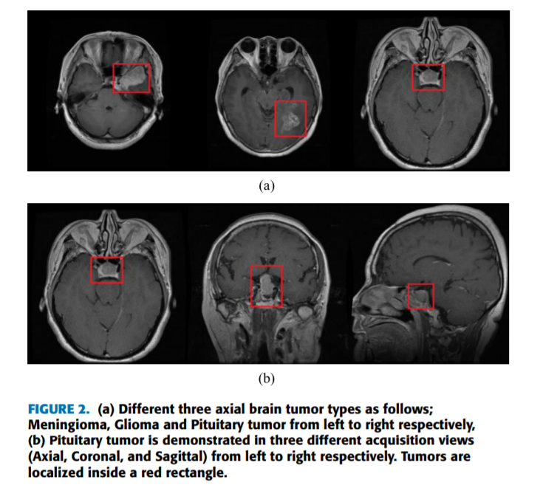
Brain tumor and its types
Brain tumor is a lump created by abnormal growth of cells in brain
Types
Primary
Secondary
Meningioma
Pituitary adenoma
Glioma
Easy to detect
Non-cancerous
Originate in brain
Easy to detect
Non-cancerous
Originate
somewhere else
Lung (50%)
Breast (15%)
Melanoma (10%)
Difficult to detect
Cancerous
Diffused structure and poor contrast
Accurate glioma segmentation is needed to detect brain cancer

Slide 33
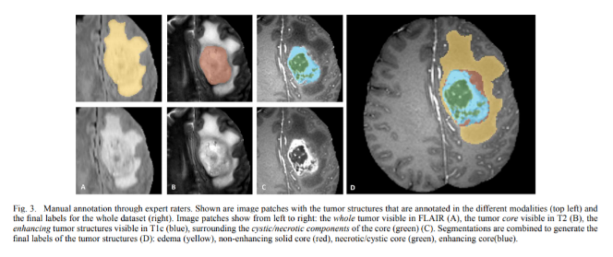
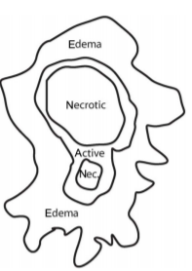
Role of MRI images
Provides unique information about different glioma segments
MRI has high-resolution imaging quality and many modalities
Glioma Segments
MRI showing glioma segments
FLAIR
T2
T1
Edema
Non-enhancing core
Complete
Core
Enhance
Enhancing core
Necrotic
MRI images are highly suitable for glioma segmentation
Notes:
Magnetic resonance imaging (MRI) currently is the most versatile and informative imaging modality for the CNS. There are a variety of reasons for this. First, MRI is detected as radio frequency (RF) signals that can penetrate the skull and spinal column without degradation. Second, the hardware used to generate MRI scans allows tremendous flexibility in imaging orientation and spatial resolution. Finally, there are numerous sources of image contrast that contribute to the characterization of structure, function, and lesions of the CNS. Some of these capabilities are covered in chapters on functional MRI and magnetic resonance spectroscopy (MRS) in this text.
https://www.sciencedirect.com/topics/medicine-and-dentistry/magnetic-resonance-imaging
MAGNETIC FIELD STRENGHT UNIT- TESLA

Slide 34
Challenges in MRI-based Glioma Segmentation
3 categories of challenges
1. MRI Artifacts | 2. Glioma Features | 3. Dataset
Noise Intensity inhomogeneity Non-standardized scale | Shape, size and location unpredictable Tumor cells affect nearby healthy cells | Huge image size Imbalanced dataset Variation in expert labelling

Slide 35
Challenges in MRI-based Brain Tumor Segmentation
3 categories of challenges
1. MRI Artifacts | 2. Glioma Features | 3. Dataset
Noise Intensity inhomogeneity Non-standardized scale | Shape, size and location unpredictable Tumor cells affect nearby healthy cells | Huge image size Imbalanced dataset Variation in expert labelling
Please Note: In this case study, I focus on presenting a feasible solution, and not on finding a research gap.

Slide 36
Challenges in MRI-based Brain Tumor Segmentation
3 categories of challenges
1. MRI Artifacts | 2. Glioma Features | 3. Dataset
Noise Intensity inhomogeneity Non-standardized scale | Shape, size and location unpredictable Tumor cells affect nearby healthy cells | Huge image size Imbalanced labels Variation in expert labelling
MRI Pre-processing

Slide 37
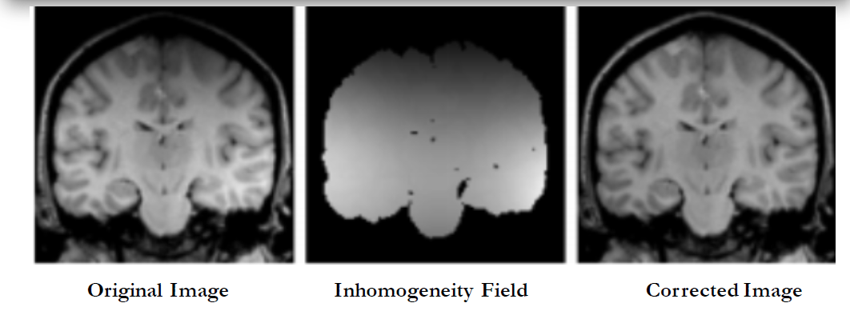
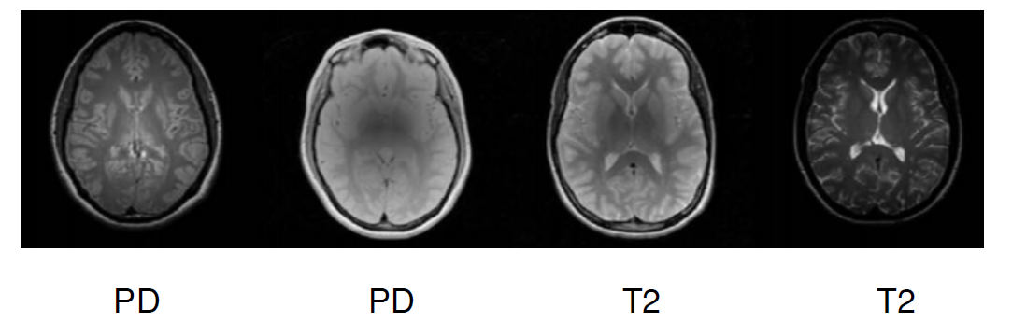

MRI Pre-processing
Noise Removal
Intensity Homogeneity
Intensity Standardization
To improve contrast between brain tissues
To remove intensity variations caused by difference in magnetic field
To standardize intensity scales varied due to different acquisition times
Original Image
Noise Suppressed
Original Image
Inhomogeneity field
Corrected
Image

Slide 38
Challenges in MRI-based Brain Tumor Segmentation
3 categories of challenges
1. MRI Artifacts | 2. Glioma Features | 3. Dataset
Noise Intensity inhomogeneity Non-standardized scale | Shape, size and location unpredictable Tumor cells affect nearby healthy cells | Huge image size Imbalanced labels Variation in expert labelling
MRI Pre-processing
Convolutional Neural Network (CNN)

Slide 39
Challenges in MRI-based Brain Tumor Segmentation
3 categories of challenges
1. MRI Artifacts | 2. Glioma Features | 3. Dataset
Noise Intensity inhomogeneity Non-standardized scale | Shape, size and location unpredictable Tumor cells affect nearby healthy cells | Huge image size Class imbalance Variation in expert labelling
MRI Pre-processing
Convolutional Neural Network
Patch Extraction
Data Augmentation

Slide 40

Proposed Solution
TRAINING PHASE
Loss function
TRAIN IMAGES
TRUE LABELS
FLAIR
T2
T1
MRI Pre-processing
Patch extraction
Data Augmentation
CNN
TEST
IMAGES
TESTING PHASE
PREDICTED LABELS
FLAIR
T2
MRI Pre-processing
Patch extraction
Trained CNN
Post-processing
T1

Slide 41



Experimental Set-up for Evaluation
Dataset- BraTS 2013-2018
Benchmark dataset
A challenge in MICCAI conference
For each brain there exists 4 modalities
T1, T2, T1-enhanced, FLAIR
Ground truth for 5 segmentation labels
non-tumor
necrosis
edema
non-enhancing tumor
enhancing tumor
Evaluation Metric
Dice Coefficient = $\frac{{2(P}_{1}∩{ T}_{1})}{P_{1}+ T_{1}}$
Sensitivity =$\frac{P_{1}∩{ T}_{1}}{T_{1}}$
Specificity = $\frac{P_{0}∩{ T}_{0}}{T_{0}}$
 | Edema |  | Enhanced tumor
 | Necrosis |  | Non-enhanced tumor

Slide 42
Future Directions
Incorporating blood reports and prescription data
Glioma grading – grade 1,2,3,4
3D CNN’s for handling voxels

Slide 43
References
Course on fundamentals of medical image analysis
CAP5516- Medical Image Computing, Prof. Ulas Bagci, UCF
Survey research papers
Litjens, Geert, et al. "A survey on deep learning in medical image analysis." Medical image analysis 42 (2017): 60-88.
Lundervold et al., "An overview of deep learning in medical imaging focusing on MRI" (2019), https://arxiv.org/abs/1811.10052
Brain tumor segmentation papers
Akkus, Zeynettin, et al. "Deep learning for brain MRI segmentation: state of the art and future directions." Journal of digital imaging 30.4 (2017): 449-459.
Havaei, Mohammad, et al. "Brain tumor segmentation with deep neural networks." Medical image analysis 35 (2017): 18-31.
Pereira, Sérgio, et al. "Brain tumor segmentation using convolutional neural networks in MRI images." IEEE transactions on medical imaging 35.5 (2016): 1240-1251.
Menze, Bjoern H., et al. "The multimodal brain tumor image segmentation benchmark (BRATS)." IEEE transactions on medical imaging 34.10 (2014): 1993-2024.
Cancer statistics
Global Cancer Observatory https://gco.iarc.fr/today/home
http://cancerindia.org.in/globocan-2018-india-factsheet/

Slide 44
Thank You!

